Slide 1
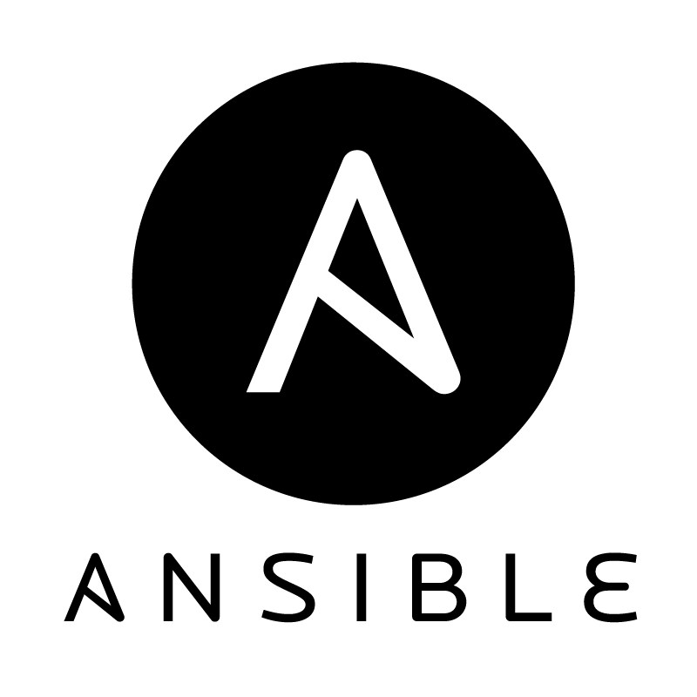
Ansible Fundamentals
David Benedic Cardinal Solutions Group

Slide 2
Overview
Ansible Fundamentals
What is Ansible?
Kick the tires
Install Requirements
Building Blocks
Take Ansible Further

Slide 3
Goal
Ansible Fundamentals
Get excited about Ansible
Build a foundation for further exploration

Slide 4
What is Ansible?

Slide 5
What is Ansible?
Ansible Fundamentals
Ansible is an automation toolbox
Notes:
Tool analogy – what is a 200 piece socket set?
Don't confuse learning Ansible with learning how to configure and administer your systems.
Ansible is a means to an end, and a reaction to a need from IT admins and DevOps teams

Slide 6
What is Ansible?
Ansible Fundamentals
A DevOps tool
Treats infrastructure as a state machine
Source Code (versioned, PRs, releases)
Differs from Puppet, Chef, PowerShell DSC
No agent
Does more than just configuration management
Easier to bootstrap
Simpler for your team to get started
Notes:
Primarily for VM configuration, but some SaaS modules exist
DevOps = the breakdown of the wall between development and operations through software-defined infrastructure and cross team cooperation.

Slide 7
What is Ansible? (cont...)
Ansible Fundamentals
Red Hat owned (purchased Ansible, Inc in 2015)
Written in Python
Current release = 2.2
Open Source (GPLv3)
Version 2.3 imminent https://github.com/ansible/ansible/blob/devel/docs/docsite/rst/roadmap/ROADMAP_2_3.rst

Slide 8
Provision
What is Ansible?
Ansible can provision infrastructure
Azure and other cloud providers
OpenStack
VMWare
Docker

Slide 9
Configuration Management
What is Ansible?
Ansible can ensure a configuration state on a host
Hosts are treated as state machines
Linux hosts – SSH
Windows hosts - WinRM

Slide 10
Orchestration
What is Ansible?
Ansible can deploy and configure systems, networks, storage, etc. in a predictable, ordered manner
e.g. remove a host, one at a time, from a load balancer pool to perform an update, upgrade or release
e.g. perform a staged deployment across a cluster
Multithreaded execution possible

Slide 11
Administration
What is Ansible?
Query host state
Make and test configuration changes
Audit hosts

Slide 12
Deployment
What is Ansible?
Ansible can manage application deployments to hosts
Sanity check deployment
Integrate into CI/CD pipeline

Slide 13
Ansible can...
What is Ansible?
Provision
Configure
Orchestrate
Administer
Deploy

Slide 14
Install Ansible

Slide 15
Control Machine
Install Ansible
Linux, Mac, and Windows (kinda)
Bash for Windows
Linux VM
Docker container
Python 2.x or 3.x (as of Ansible 2.2)
PyWinRM and/or Paramiko
Ansible
Installed via package manager of choice, including pip
Checkout from GitHub
Container registry

Slide 16
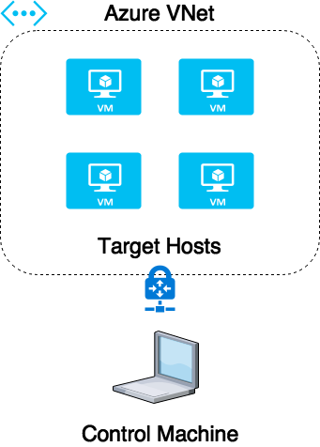
Target Host
Install Ansible
Cloud
Local
Container
VM
Physical
Control machine needs network connectivity to target host(s)

Slide 17
Target Host cont...
Install Ansible
Python 2.x or 3.x
SSH (Linux) / WinRM (Windows)
No Agent Required

Slide 18
Building Blocks

Slide 19
Ansible Playbook
Building Blocks
"Playbooks are the language by which Ansible orchestrates, configures, administers, or deploys systems. They are called playbooks partially because it’s a sports analogy, and it’s supposed to be fun using them. They aren’t workbooks :)"
http://docs.ansible.com/ansible/glossary

Slide 20
Inventory
Building Blocks
The inventory categorizes and organizes the target hosts you want to Ansible to manage
Host: a single target host
Group: a named group made up of one or more hosts
Host/Group Variable: specific configuration or variables set for a host or group
Group of Groups: a named group made up of multiple one or more child groups
Can contain a mix of Windows and Linux hosts

Slide 21
Task
Building Blocks
A single configuration to execute on a target host
Multiple tasks run in order as part of a playbook
Tasks can be dependent on other tasks
All tasks should be named
Designed to be run repeatedly to ensure a desired state
Idempotent
Abstracted away by module

Slide 22
Hello World!
Demo

Slide 23


Slide 24
Module
Building Blocks
Modules are an interface into a configuration on a machine
Abstracts out complexity
Designed to be pluggable into Ansible (meaning you can write your own)
Several hundred already exist in the official repository
ansible-doc command makes it easy to view modules and documentation

Slide 25
Role
Building Blocks
Collection of tasks, variables, files, and templates
Typically associated with a server role
May not be used initially – reveal themselves further in development

Slide 26
Playbook
Building Blocks
A collection of tasks and/or roles that run against hosts or groups in inventory
Multiple playbooks may exist in the same Ansible repository
Microservices

Slide 27
Take Ansible Further

Slide 28
Ansible Galaxy
Take Ansible Further
Community of shared Ansible roles
ansible-galaxy command line tool makes it easy to search and install roles from the Galaxy into your Ansible repository
https://galaxy.ansible.com/

Slide 29
Dynamic Inventory for Microsoft Azure
Take Ansible Further
Simplifies manage of hosts at cloud scale
Inventory is populated based on Azure resource tags
Hosts must be resolvable from control machine via hostname only (not FQDN) - implies DNS resolution
Jump host/Bastion host in the Azure VNet works well with dynamic inventory
https://docs.ansible.com/ansible/guide_azure.html

Slide 30
Ansible Console
Take Ansible Further
ansible-console command line tool
Powerful visibility into Ansible inventory

Slide 31
Get Started Now
Take Ansible Further
https://github.com/daveyb/ansible-fundamentals
@davidbenedic

Slide 32
Thank You!

